Slide 1

DESIGN & DEVELOPMENT OF INTERIOR IMAGE CAPTURING SYSTEM FOR INDIRECT SOLAR DEHYDRATOR Department of Electronics & Communication Engineering
Presented By
S . Samba Siva Reddy (A21126512178)
S . Angel Shainy (A21126512174)
R . Siva Sai Tejesh (A21126512171)
K . Rama Devi (A21126512146)
Under the Guidance of
Dr . G Prasanna,
Assistant Professor,Dept of ECE

Slide 2
ABSTRACT
Indirect solar dehydrators offer sustainable alternative by utilizing solar thermal energy to remove moisture from vegetables, which extends their shelf life without artificial preservatives. However, these devices have not gained widespread consumer acceptance due to a lack of trust[1] in the hygiene aspect of the indirect drying process. Moreover, inefficiencies due to heat loss caused by manual open-door-inspections also make them an unfavourable choice. Both of the above drawbacks can be addressed by integrating a camera[2] inside the drying chamber. To operate a camera inside the hot drying chamber, it should sustain high temperatures (~80 deg C) and high humidity (80%). Although commercial cameras report function in this temperature and humidity range, there is a requirement to test them before deploying them in the drying chamber. In the present work, an IoT enabled automated hot chamber which emulates a solar dehydrator environment is designed and developed.

Slide 3
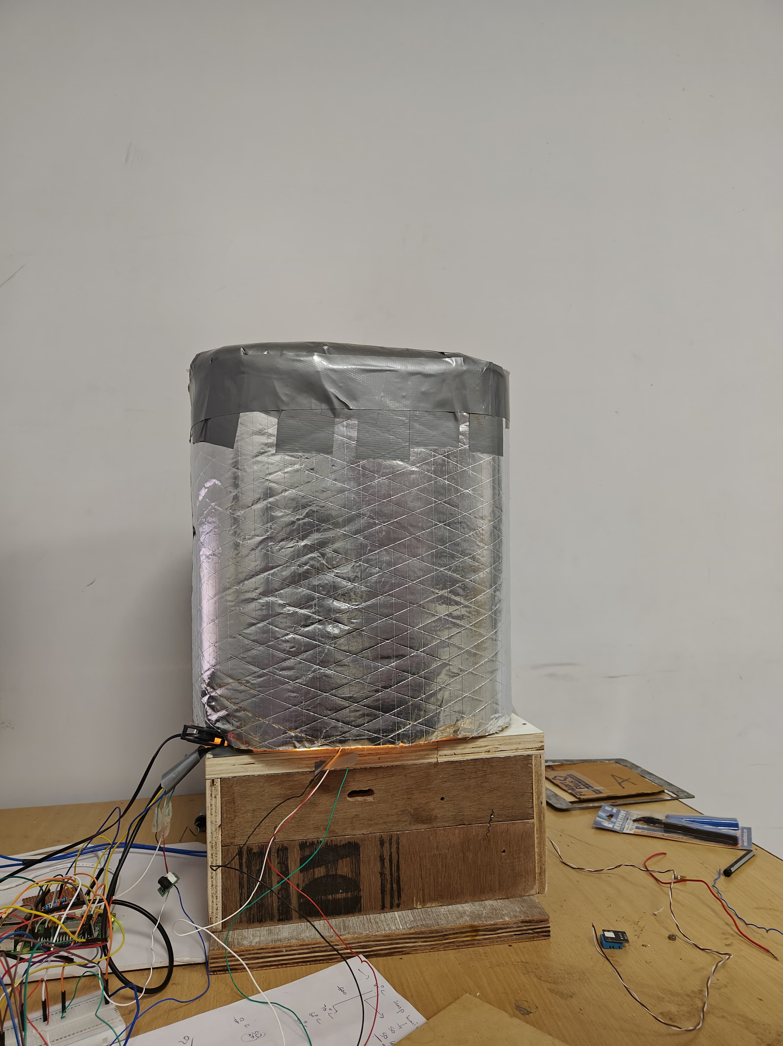
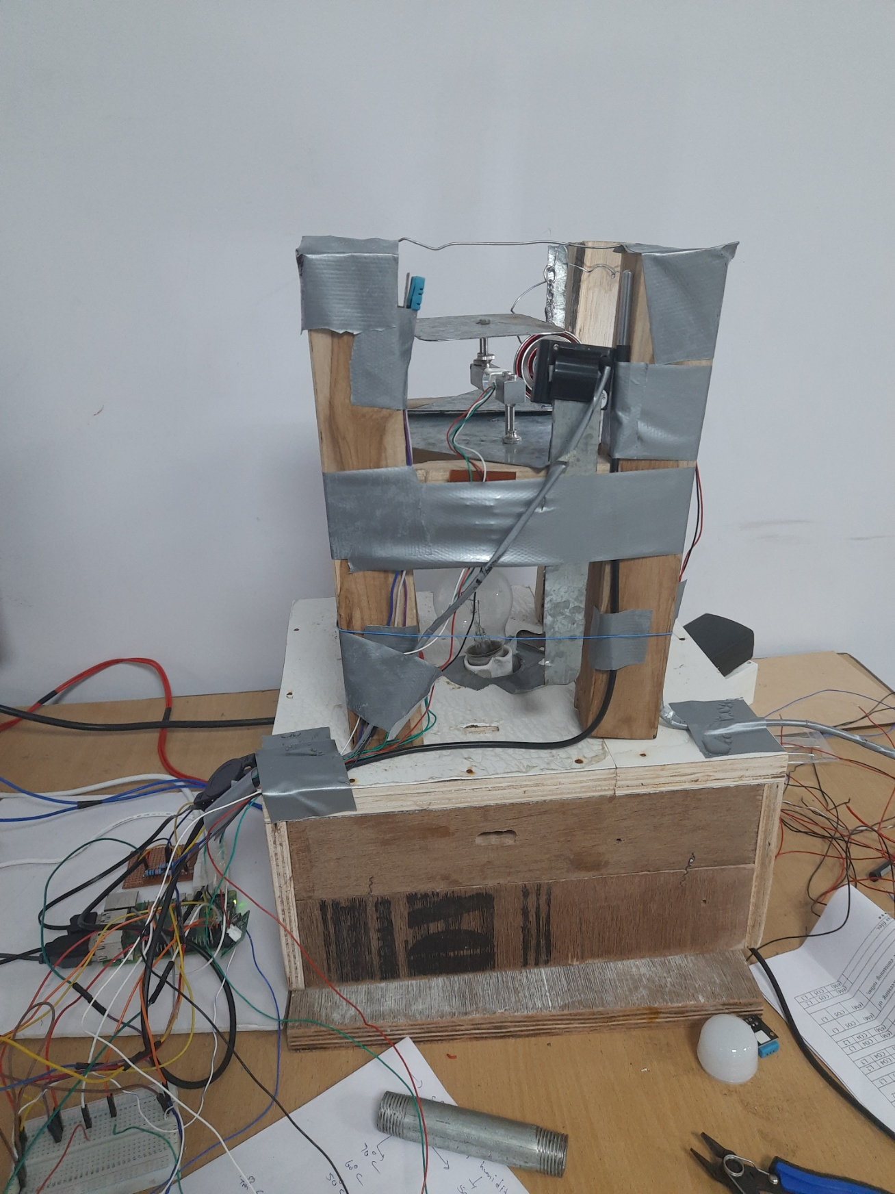
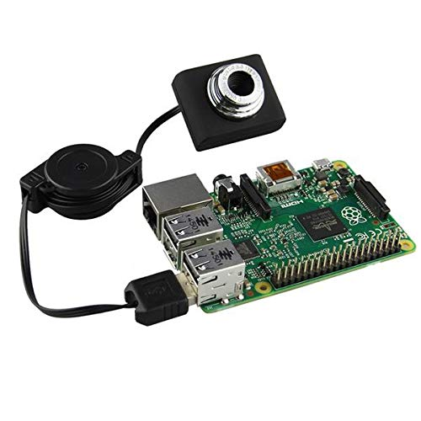

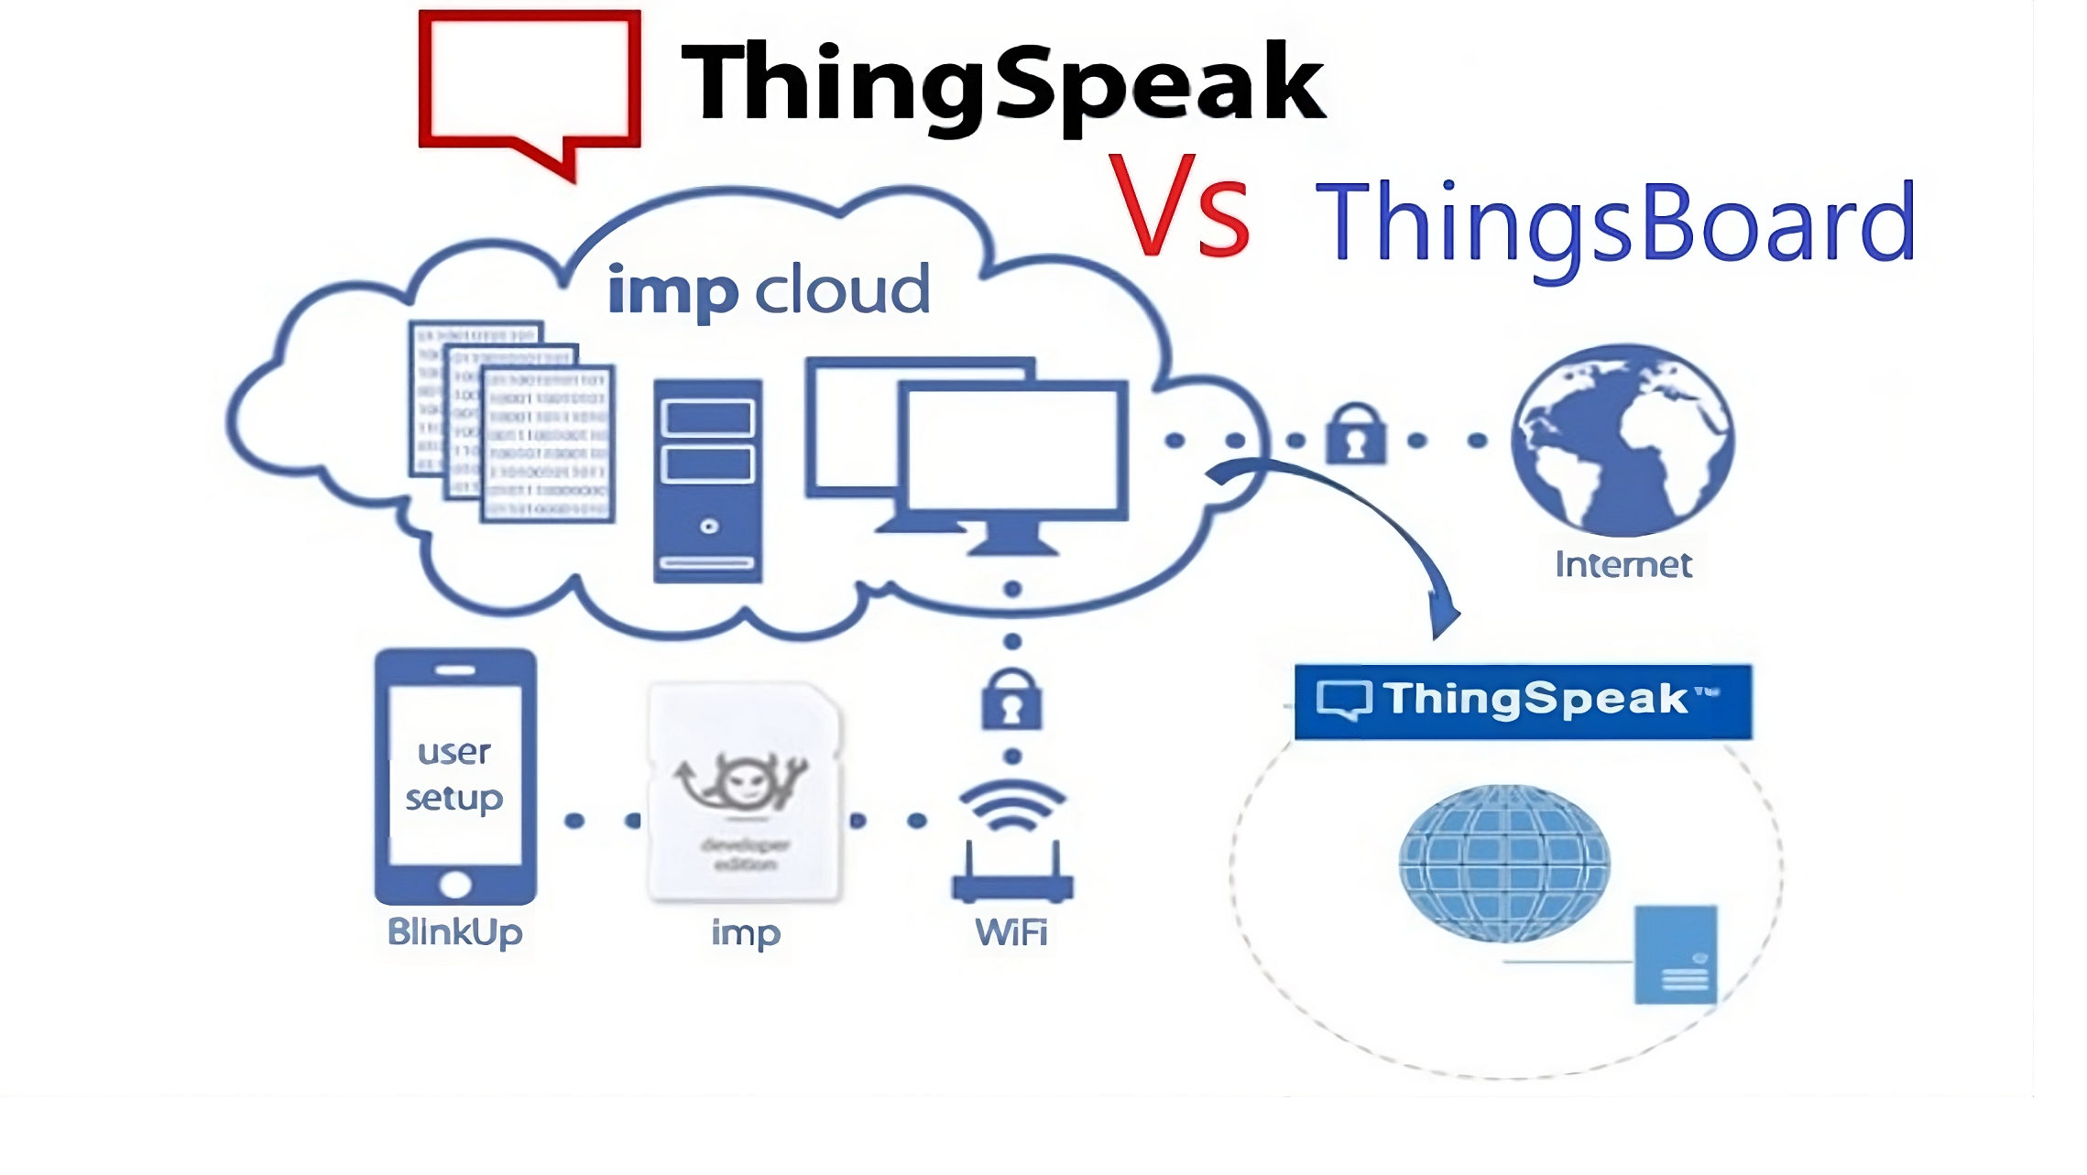
Objective
Developing an customized chamber which reflects same
environment as indirect solar dehydrator
Embedding the sensors inside the chamber to get chamber conditions.
Integrating USB camera with raspberry pi and capturing images.
Storing & accessing the captured images from cloud platform.
Getting the sensor data and analyze it & upload to thingspeak and csv file.

Slide 4
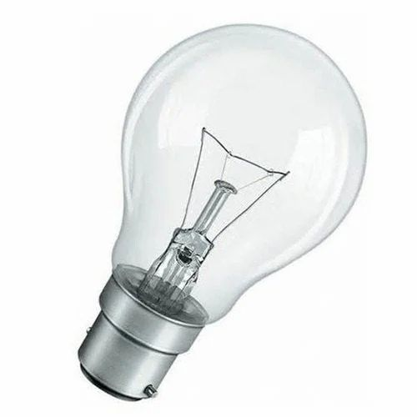
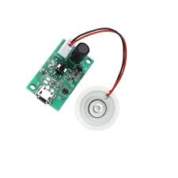
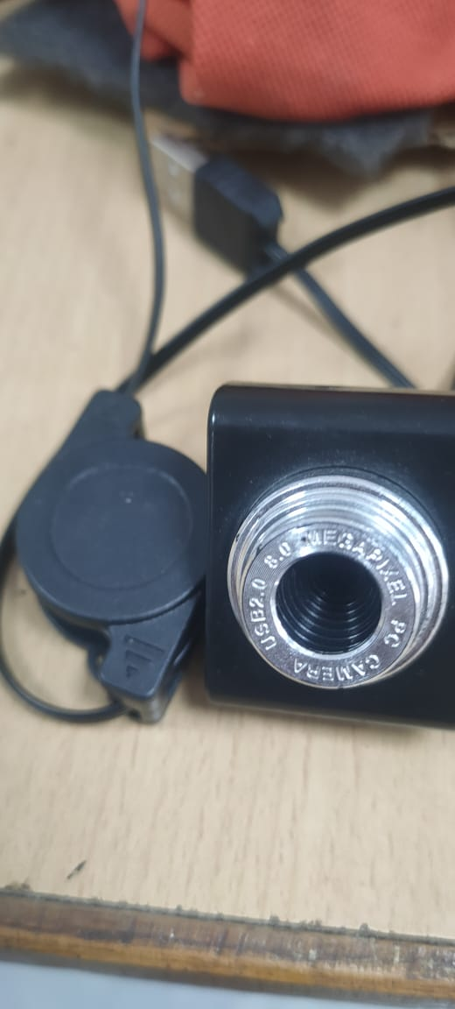
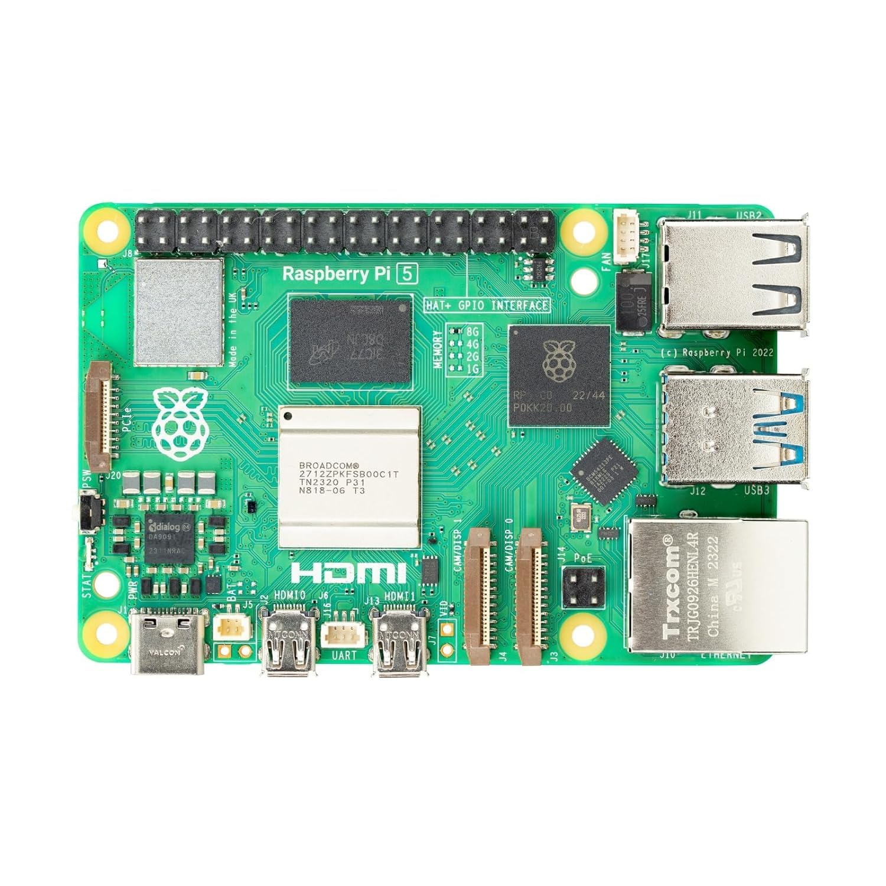


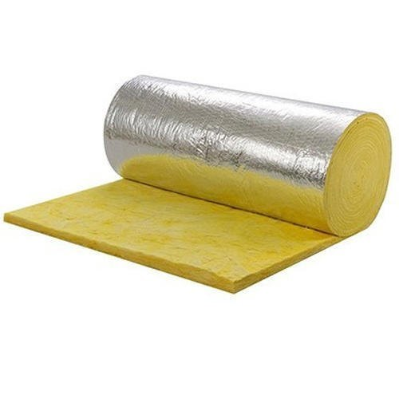
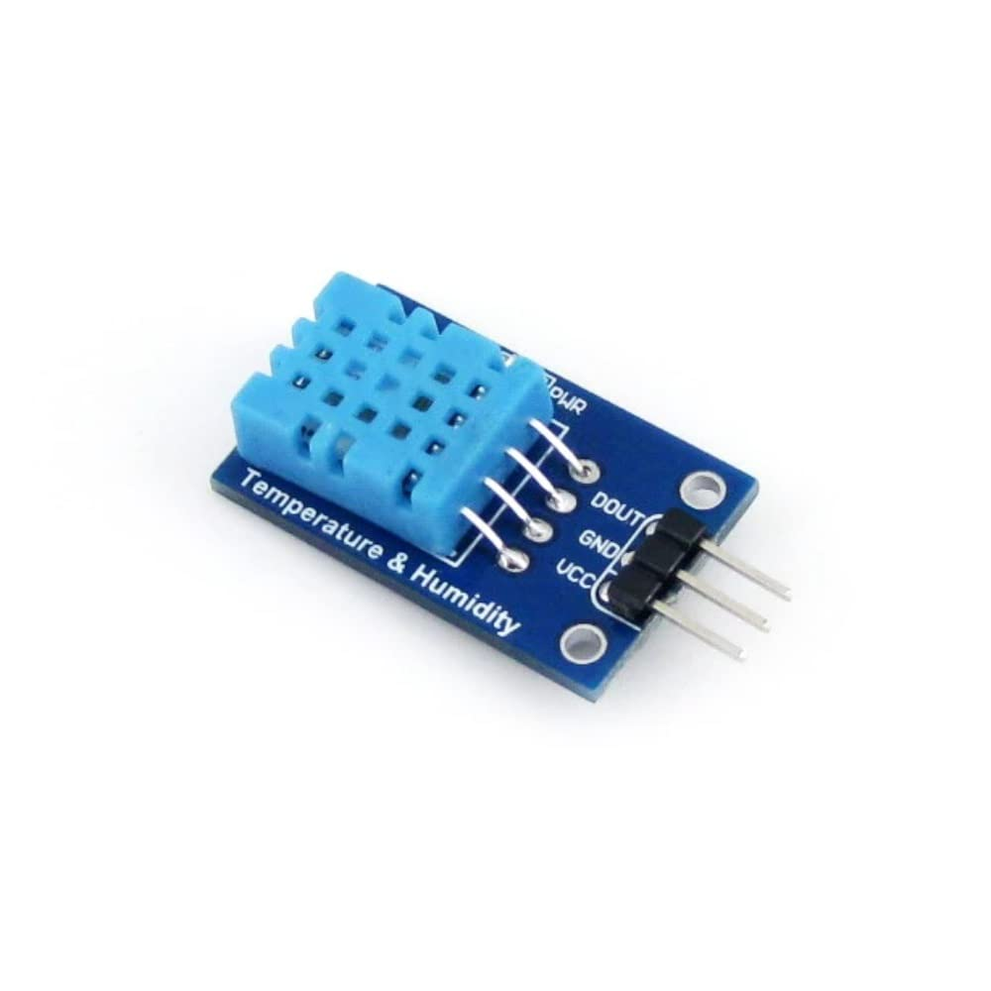
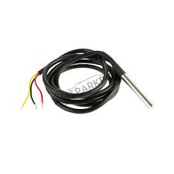
Process Flow & Tools Used
Tools used And Flow

Slide 5
Methodolgy inside the chamber
Capturing a reference image
Obtaining the readings from sensors
Humidity fromDHT 11
Temperature from DS1B20
Checking user input conditions
Capturing the images and storing in a folder
Uploading the stored images to google drive
Calculating PSNR between taken image and reference image.
Uploading sensor data and PSNR to thingspeak.
Updating CSV file with sensor data and PSNR values.
Temperature and humidity limit

Slide 6
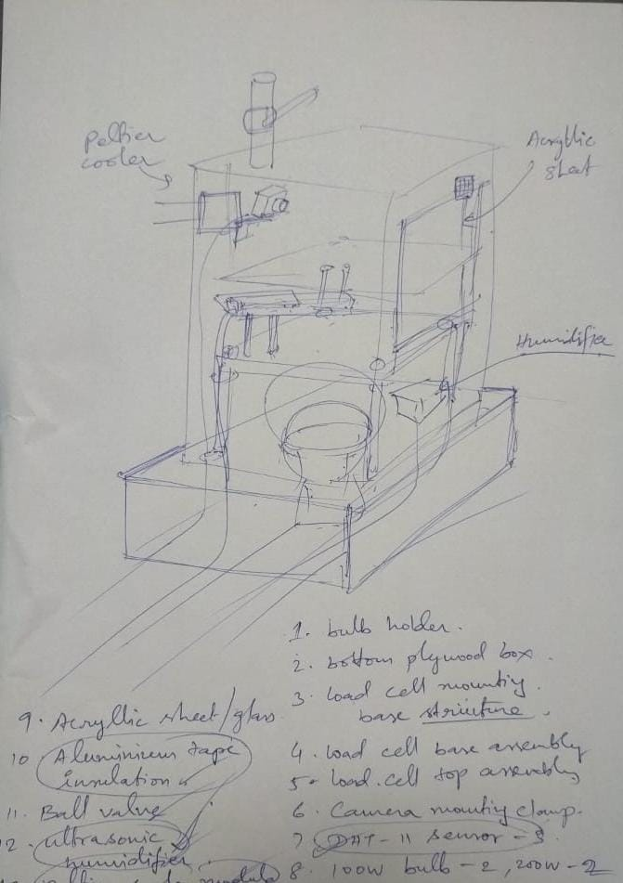
CHAMBER DESIGN & IMPLEMENTATION

Slide 7
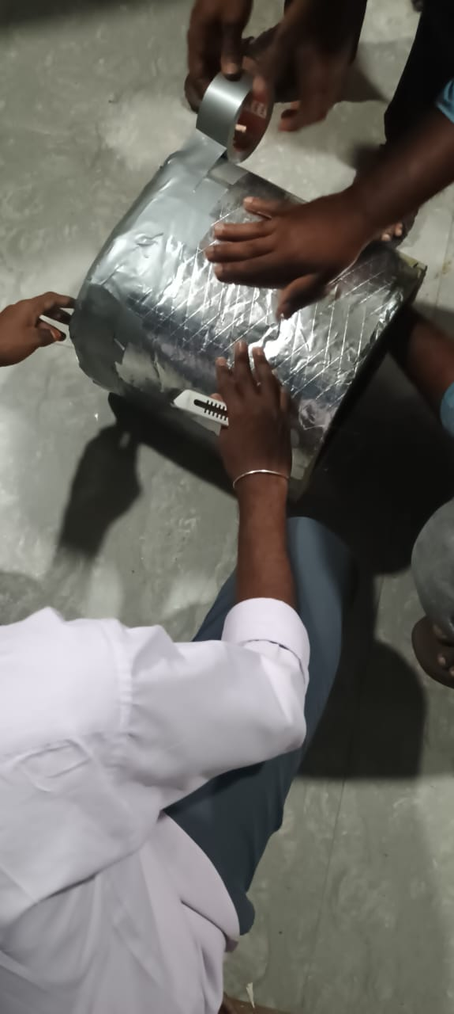
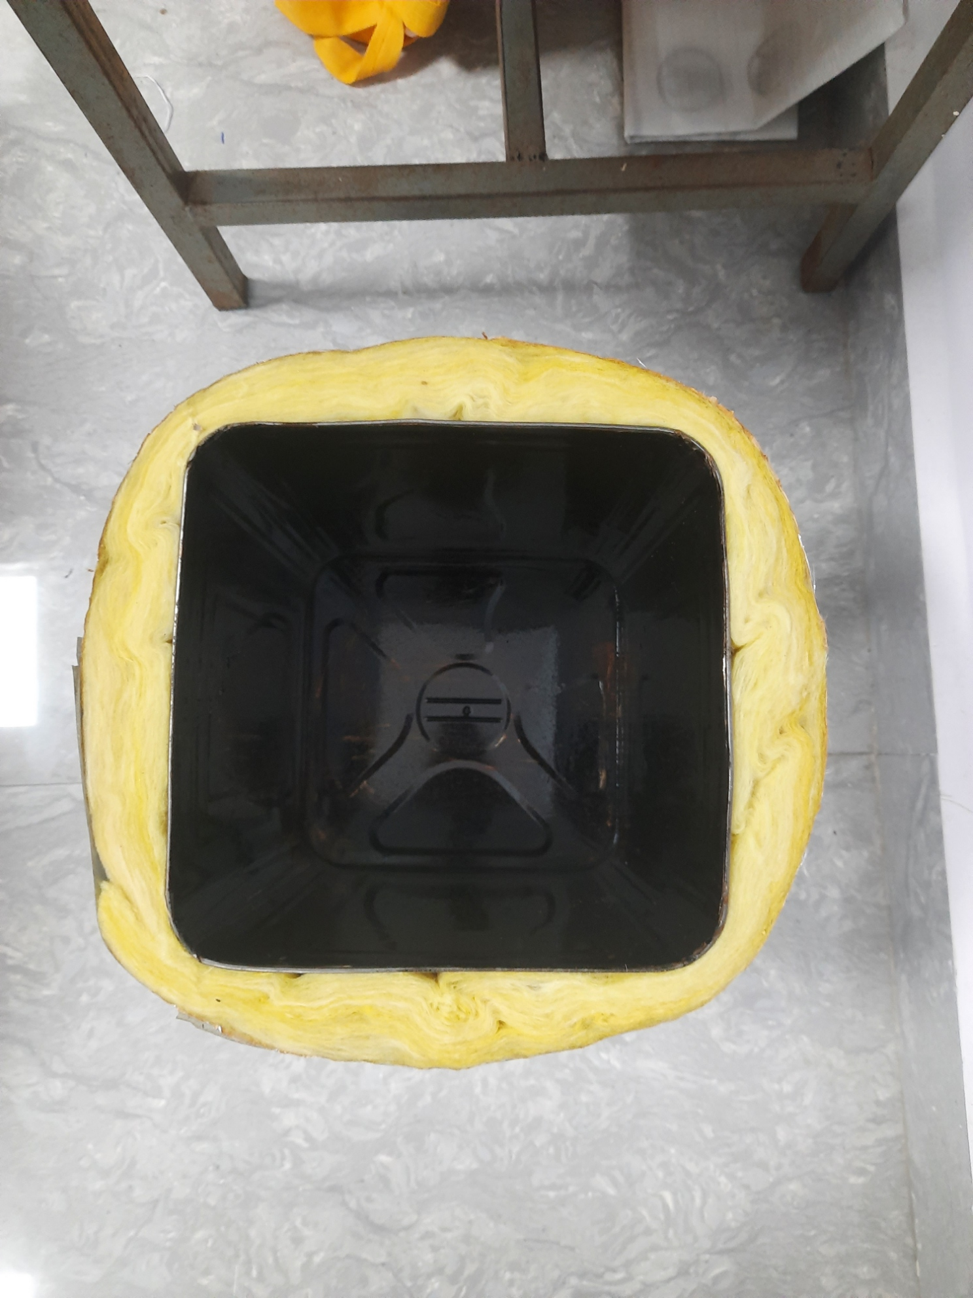
Insulation Of Chamber using glass wool

Slide 8
Testing
Tested the camera in the chamber, Up to maximum temperature produced by the bulb i.e. 80 degrees. And humidity value of 80%.
Analyzed data through graphs, obtained from DHT 11 and DS1B20 sensors inside the customized chamber and calculated PSNR values.
The respective data get updated to cloud platform
The data obtained during real time testing was compared and analyzed.

Slide 9
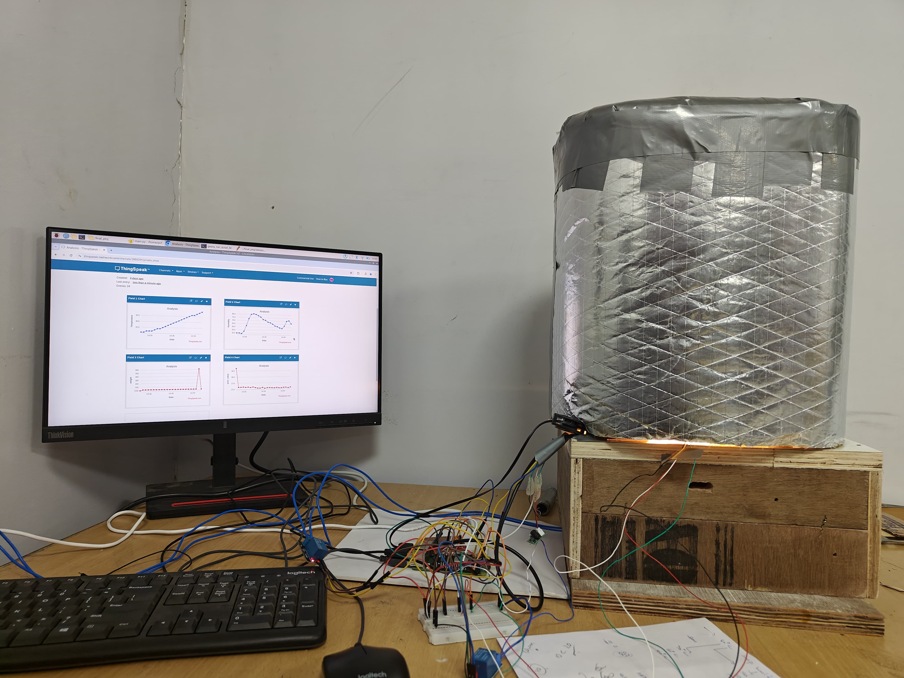
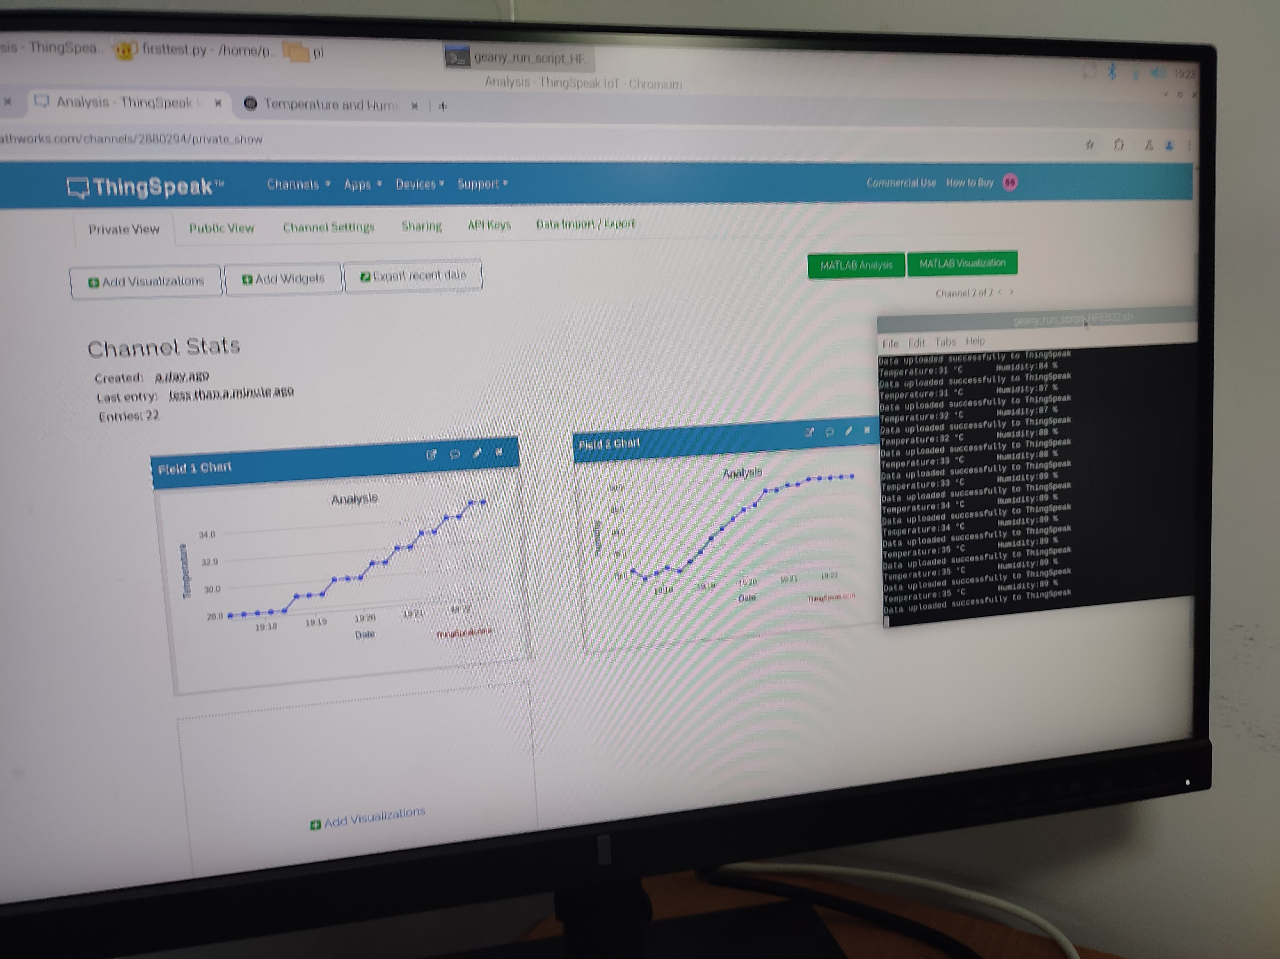
Bench setup and Testing images

Slide 10
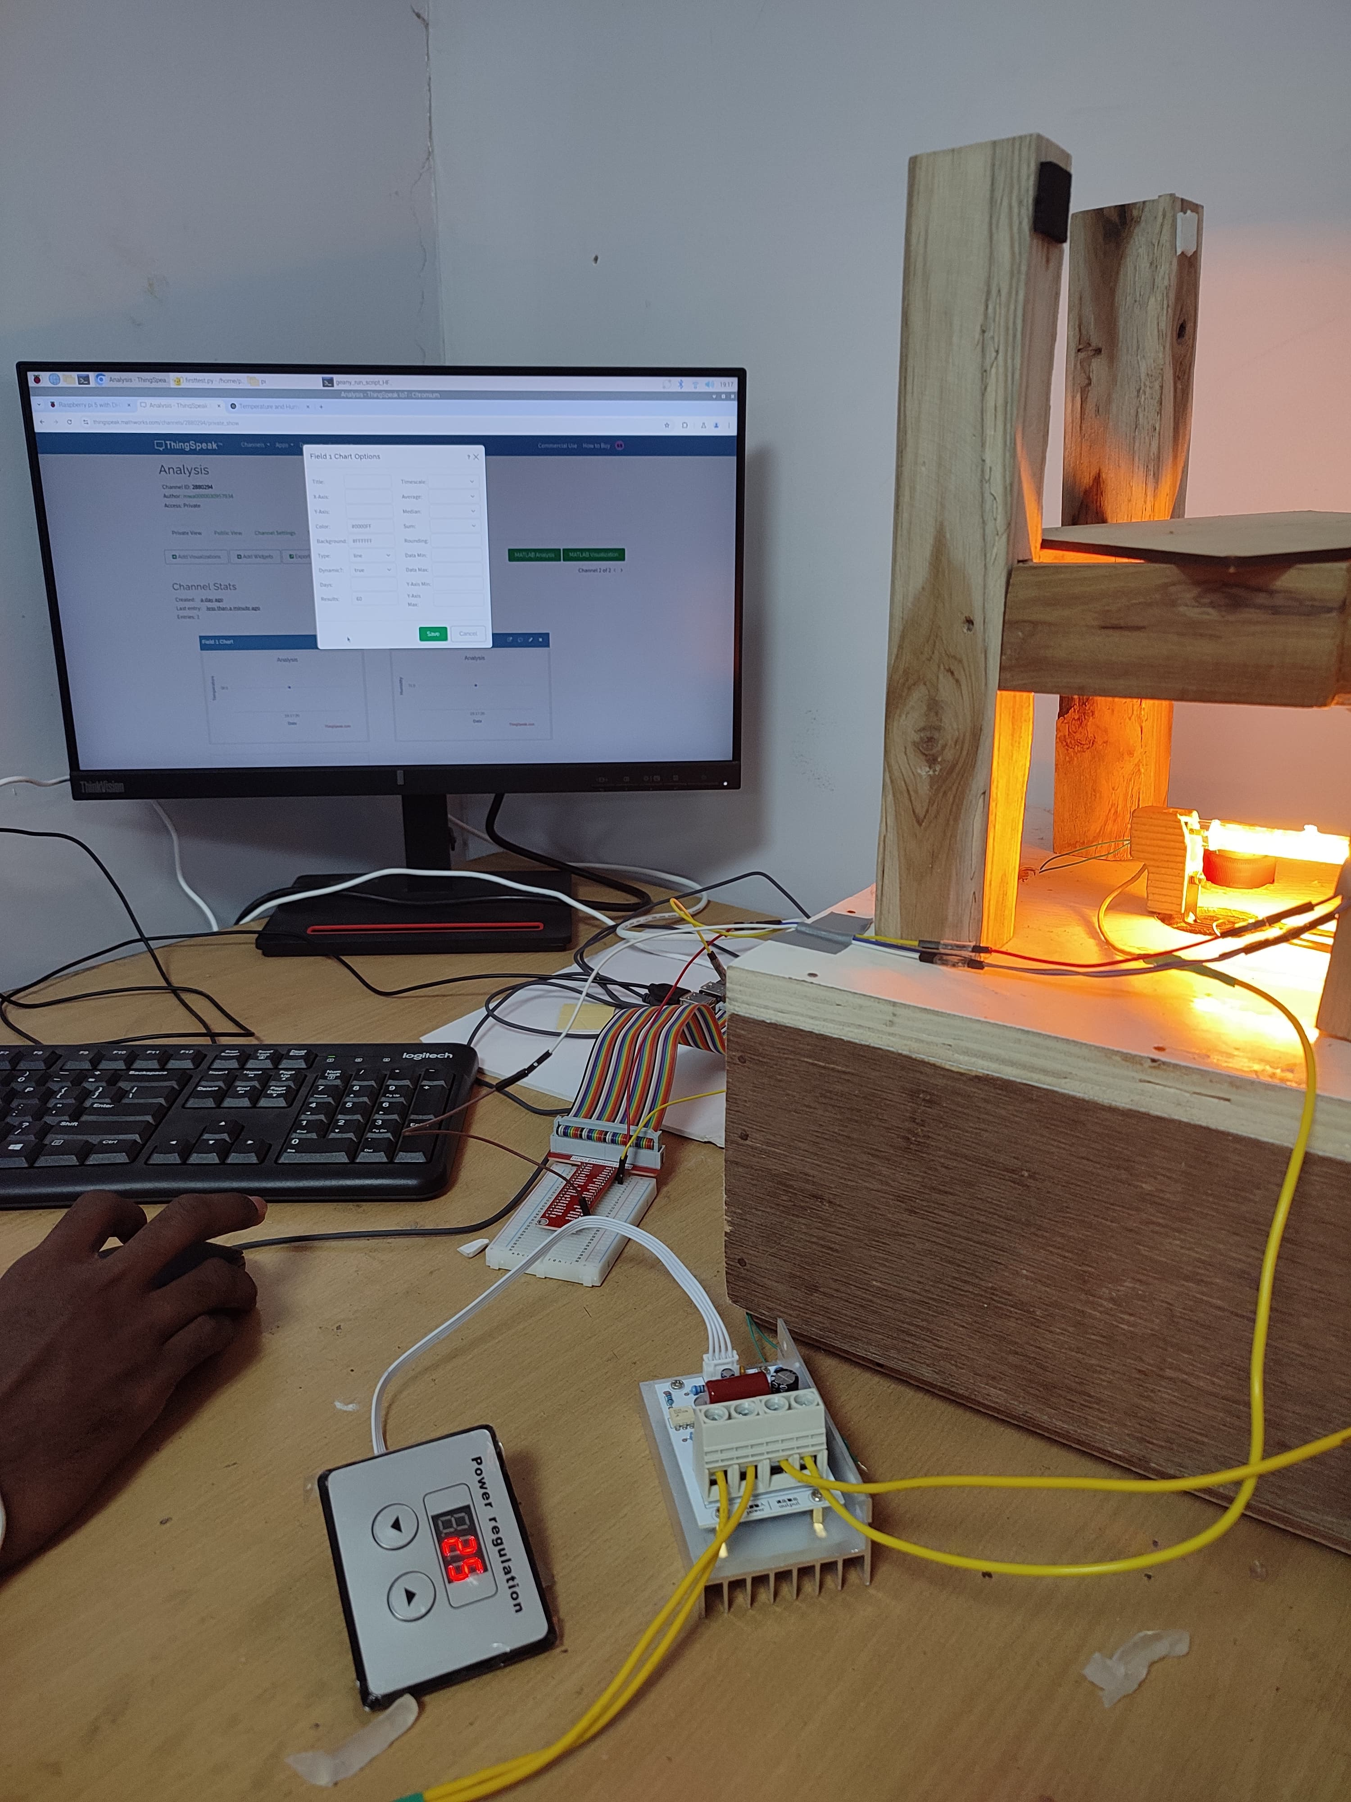

Slide 11
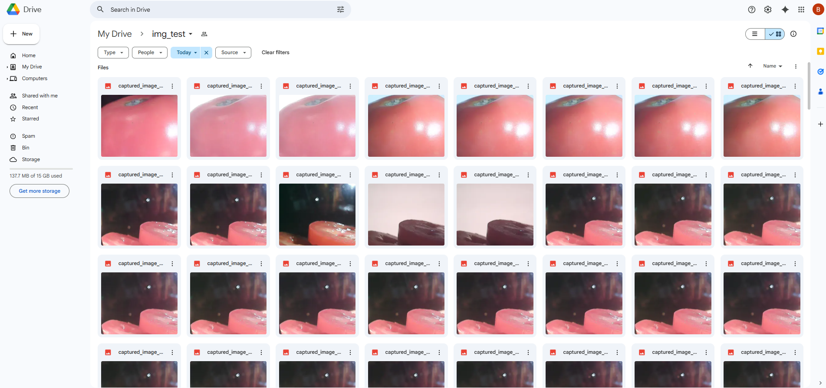
Upload Images to google drive:
Available cloud platforms: Google drive, One drive, Dropbox, Amazon s3, Git hub.
We have used Google drive for storing the captured images , which provides 15GB storage. Here are some stored images

Slide 12
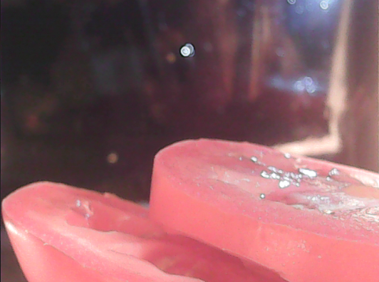
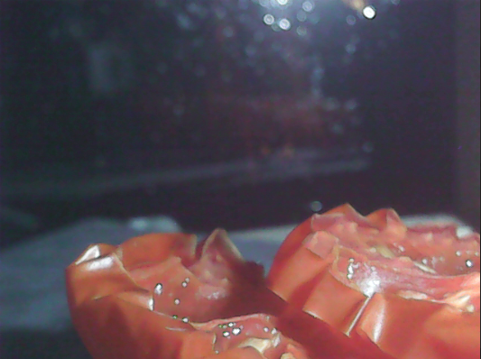
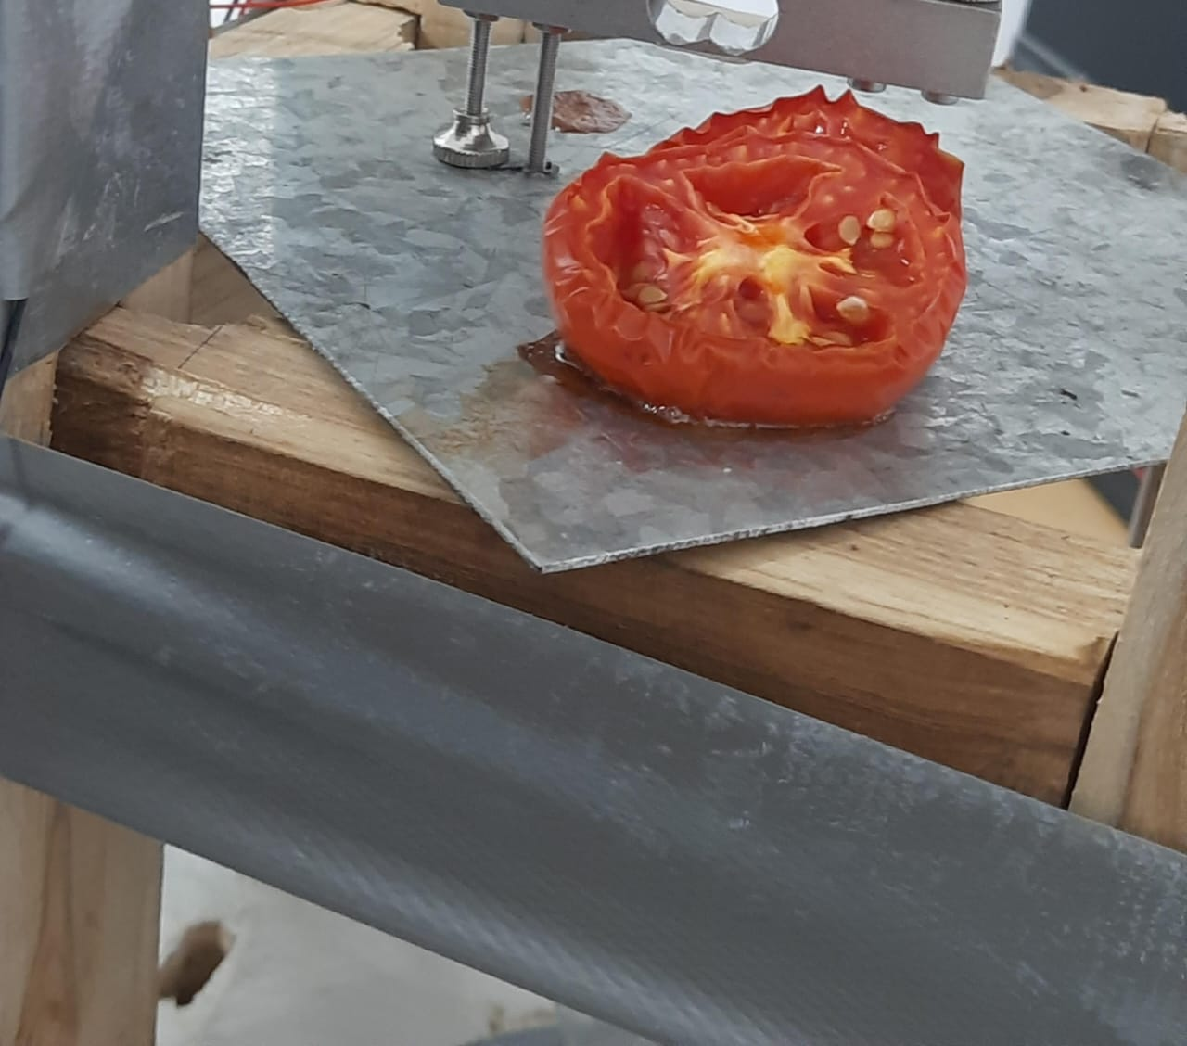
Before Dehyadration
After Dehyadration

Slide 13
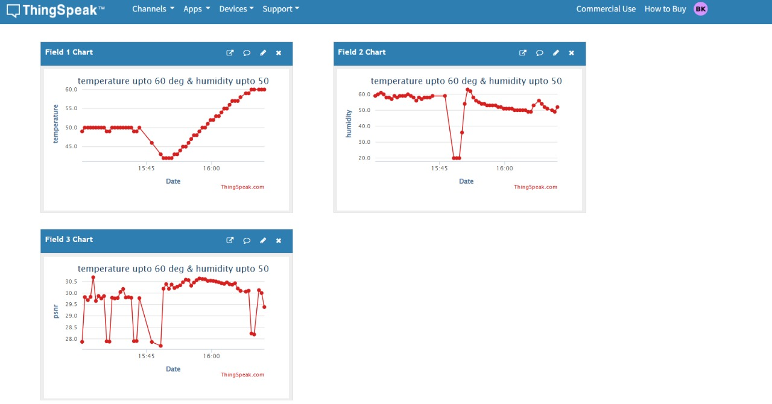
PSNR when temperature varies from 30 c to 60 c and humidity 40 rh to 50 rh

Slide 14
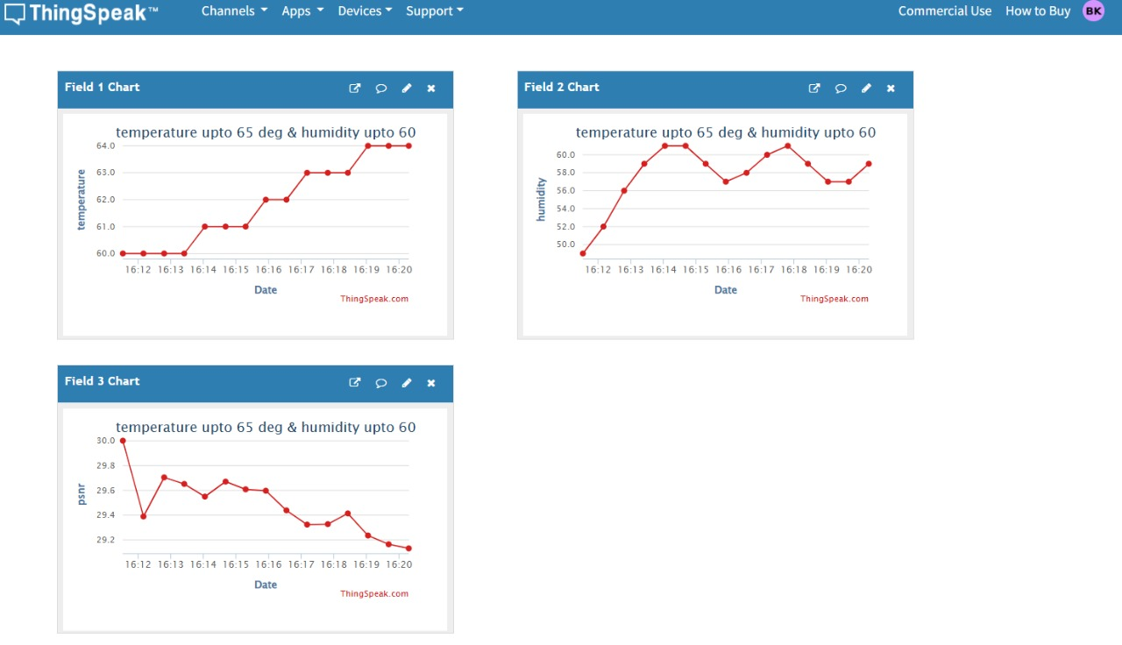
PSNR when temperature varies from 60 c to 65 c and humidity 50 rh to 60 rh

Slide 15
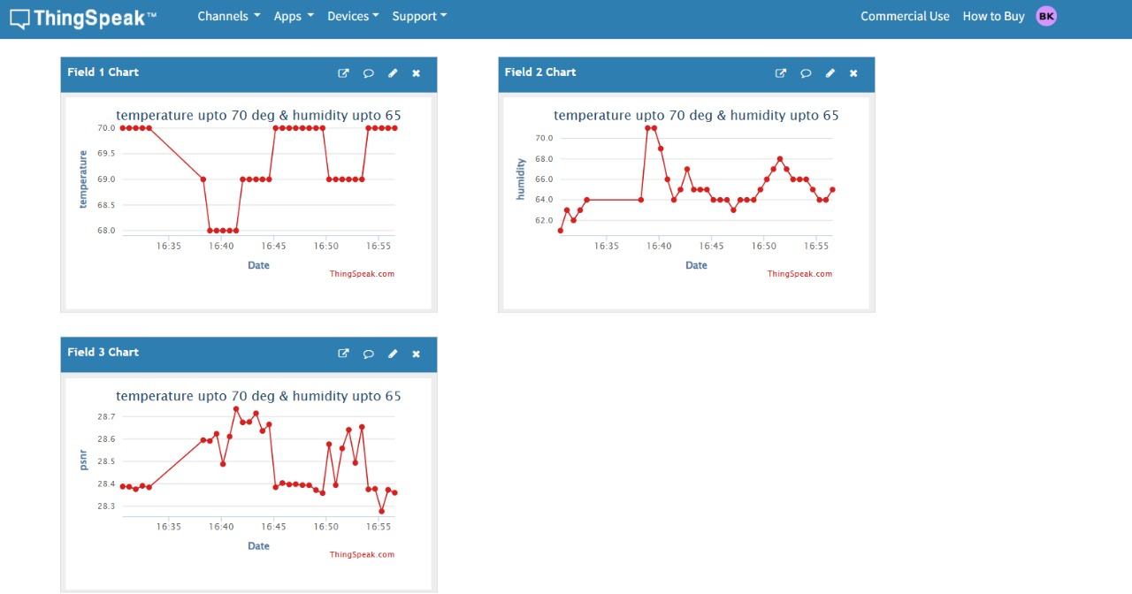
PSNR when temperature varies from 65 c to 70 c and humidity 60 rh to 65 rh

Slide 16
PSNR when temperature varies from 70 c to 75 c and humidity 60 rh to 65 rh

Slide 17
LINKS OF PROJECT
VIDEO LINK:
https://drive.google.com/file/d/1p9msP8or4i9YHtH6KKjXgjHxVHVOD4rp/view?usp=sharing
Images folder Link :
https://drive.google.com/drive/folders/1vPDTEbKkqFvb32-u6v5TalhPMn-EWwJ7?usp=sharing
CSV file link:
csv.file
Code link:
code.py

Slide 18
Conclusion
This project aims to revolutionize the solar dehydration process by introducing a specialized camera system for real-time monitoring.
The obtained PSNR values are in range between 27db to 29db[3],camera functions properly in it .
By replacing manual inspections increases the efficiency of the device.
Trust and Transparency
Cost-effectiveness of the dehydration process.
Addresses key challenges in food preservation.

Slide 19
References
[1]-Lam, T. K., Heales, J., Hartley, N., & Hodkinson, C. (2020). Consumer Trust in Food Safety Requires Information Transparency. Australasian Journal of Information Systems, 24. https://doi.org/10.3127/ajis.v24i0.2219
[2]-Electronics 2020, 9(3), 505; https://doi.org/10.3390/electronics9030505
[3]-N. Ponomarenko; V. Lukin; K. Egiazarian; J. Astola; M. Carli; F. Battisti ,10.1109/MMSP.2008.4665112

Slide 20
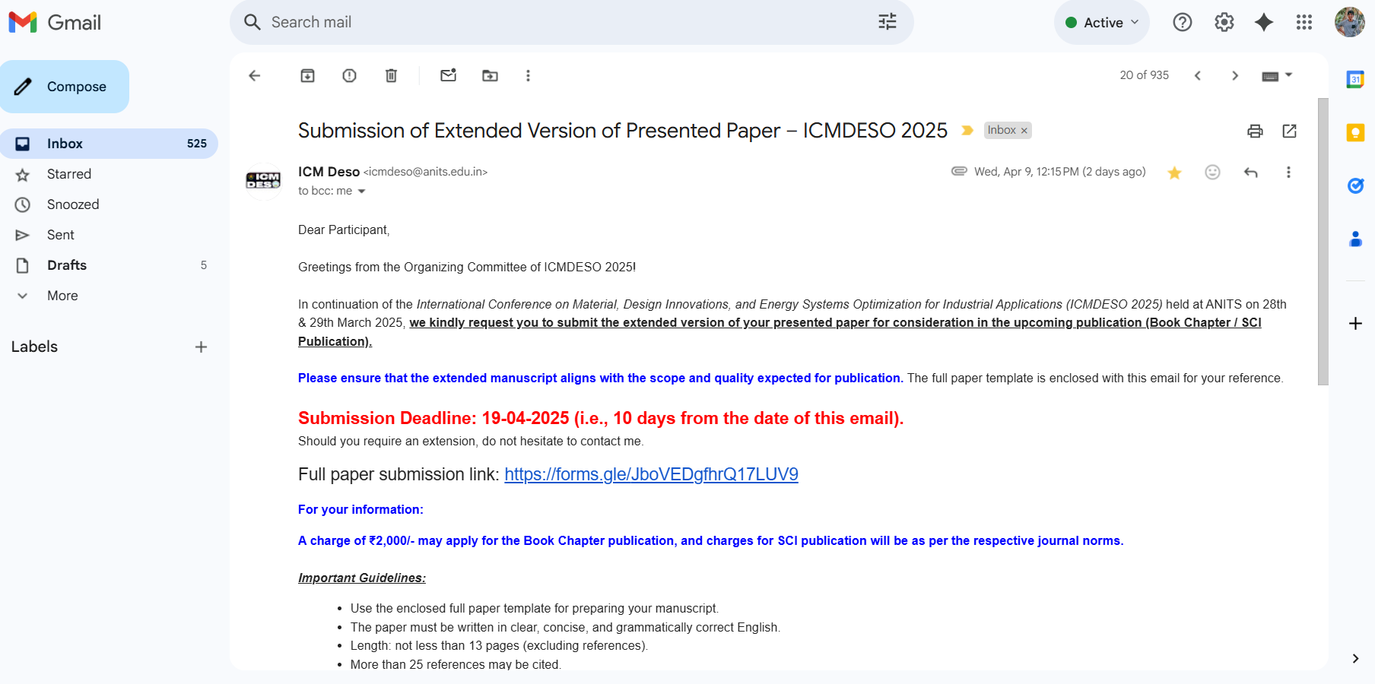
Proof Of Conference paper

Slide 21
THANK YOU

